Slide 1

CRM Analytics
Final presentation
Group-5
Lavankula Mohan Surya Pavan Kumar
surya9393L@gmail.com

Slide 2





Structure the final presentation in PPT format, following a logical order
Report Preparation and final Submission
0
Final Presentation & Report Preparation
Group Details – Team members and roles.
Project Summary – Brief overview of objectives and impact.
KPI List – Key performance indicators and their business relevance.
Excel Dashboard – Initial findings and data trends.
Tableau Dashboard – Interactive visualizations and insights.
Power BI Dashboard – Advanced analytics and performance tracking.
SQL Query Image – Schema and queries used for data transformation.
Key Takeaways – Business insights, challenges, and future recommendations
2

Slide 3
Project Summary
Impact
Customer Engagement: Insights from lead sources, stages, and industries boost targeted marketing and sales.
Retention and Growth: Trend analysis and conversion metrics enhance retention and revenue.
Decision-Making: Interactive dashboards enable real-time collaboration and optimized outcomes.
Objectives: Provide insights into CRM data, track KPIs (e.g., conversion rates, expected revenue), and enable real-time decision-making via interactive dashboards.

Slide 4
KPI List
KPIs for Opportunity Dashboard
Expected amount
Active Opportunities
Conversion Rate percentage
Loss Rate percentage
Win Rate percentage
KPIs for Lead Dashboard
Total Leads
Converted Accounts
Lead By Stage
Lead By Industry
Conversion Rate of Leads

Slide 5
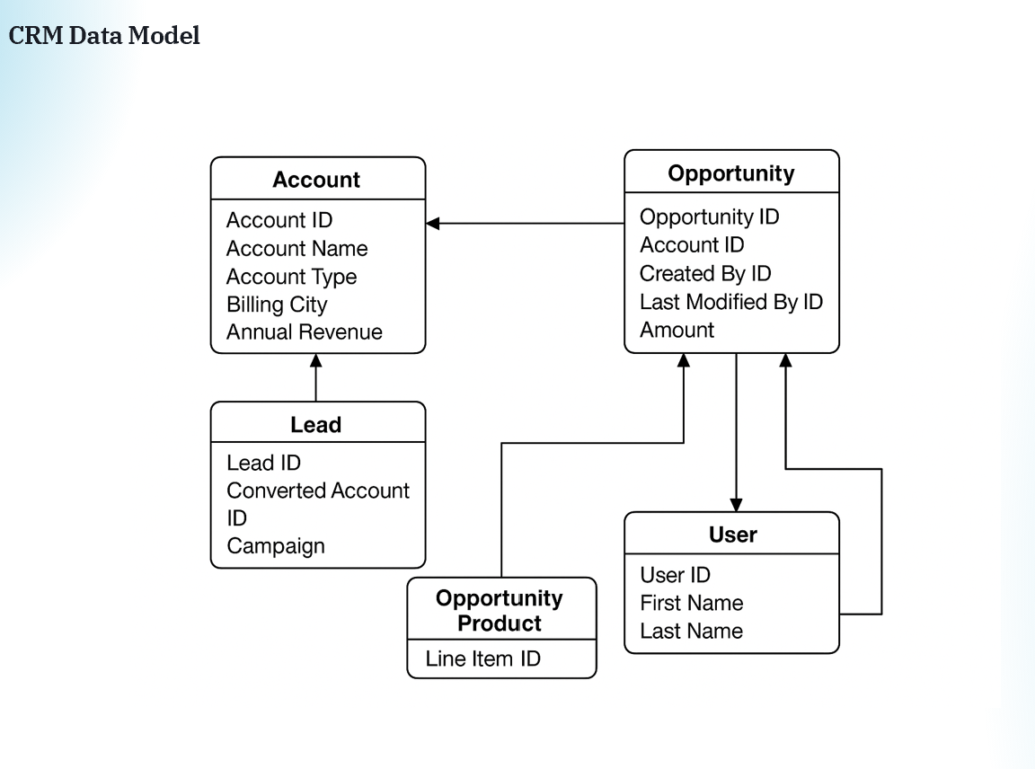

Slide 6
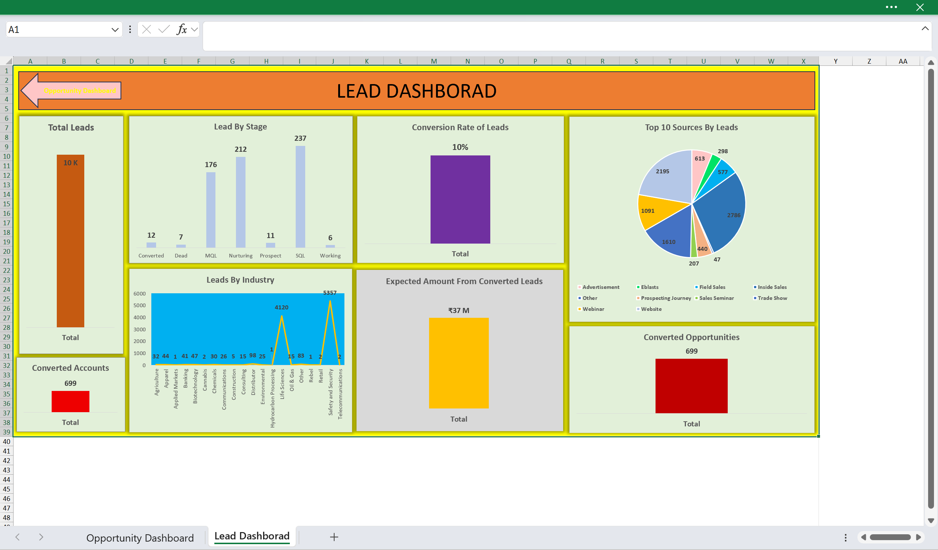
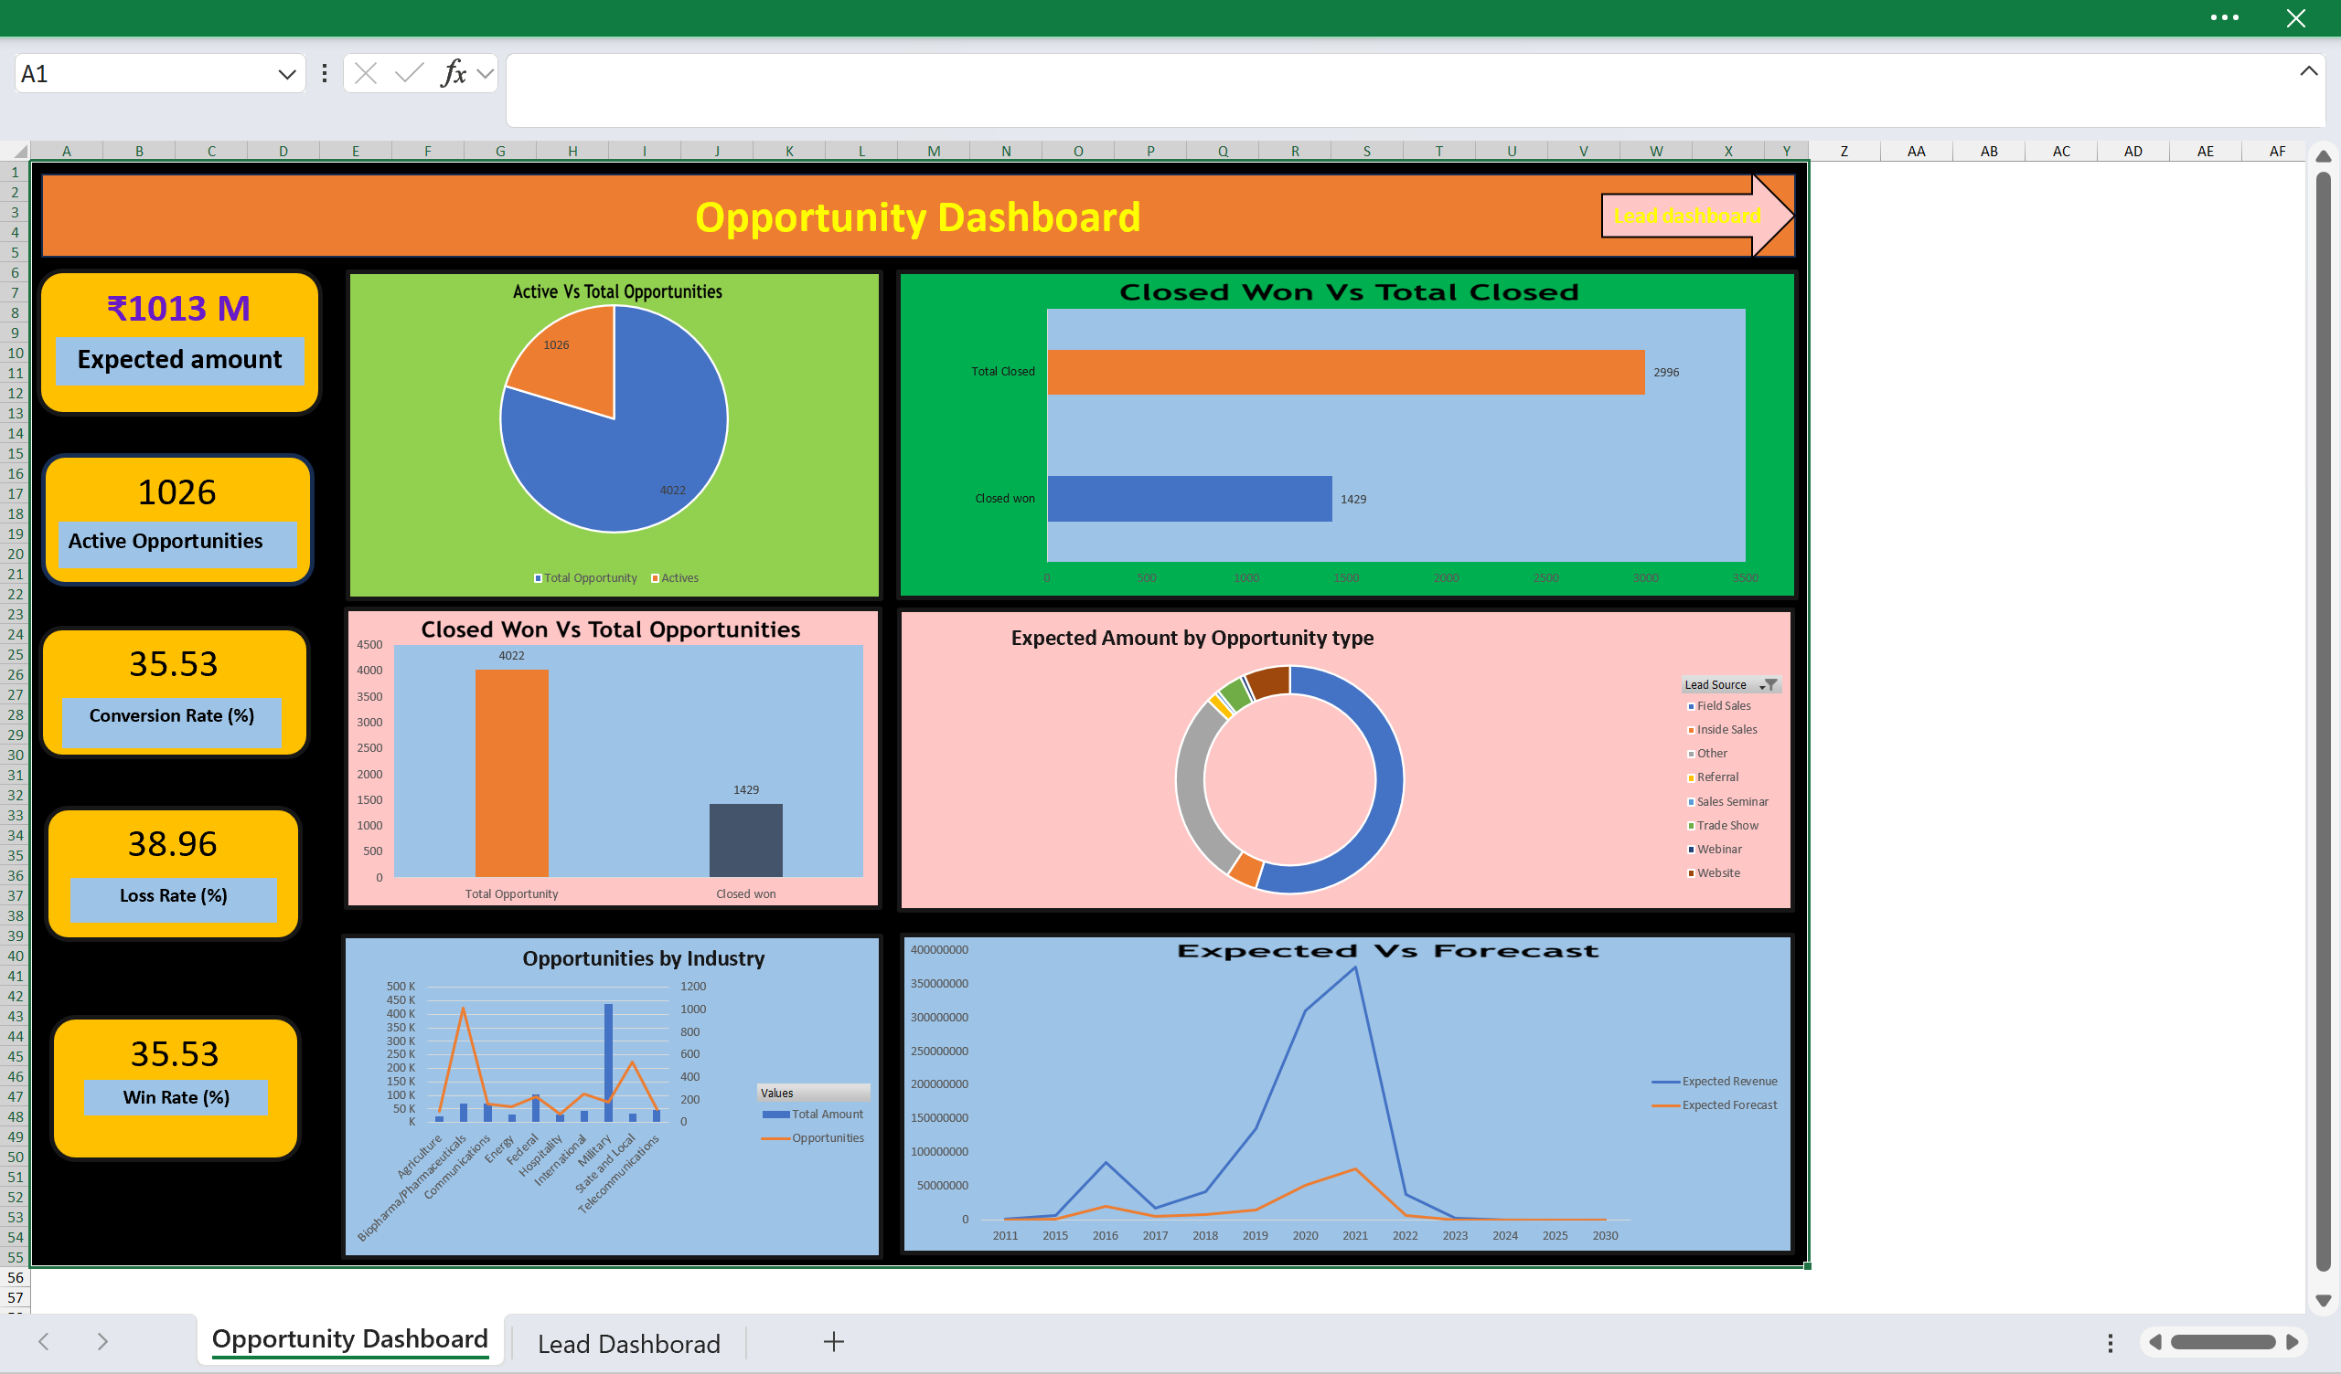
Lead Dashboard: 10K Total Leads, $184M Expected Amount, 10% Conversion Rate, 699 Converted Accounts, 699 Converted Opportunities, top source Webinar (2,786).
Excel Dashboard
Opportunity Dashboard: $1,013M Expected Amount, 1,026 Active Opportunities, 35.53% Conversion Rate, 38.96% Loss Rate.

Slide 7
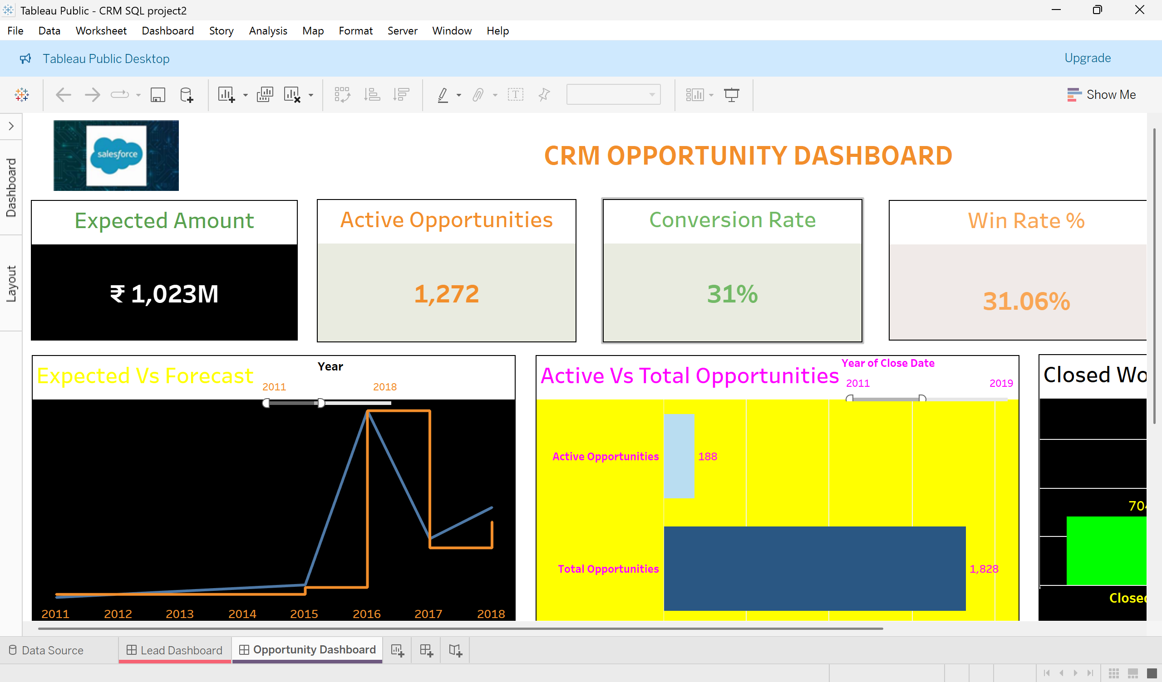
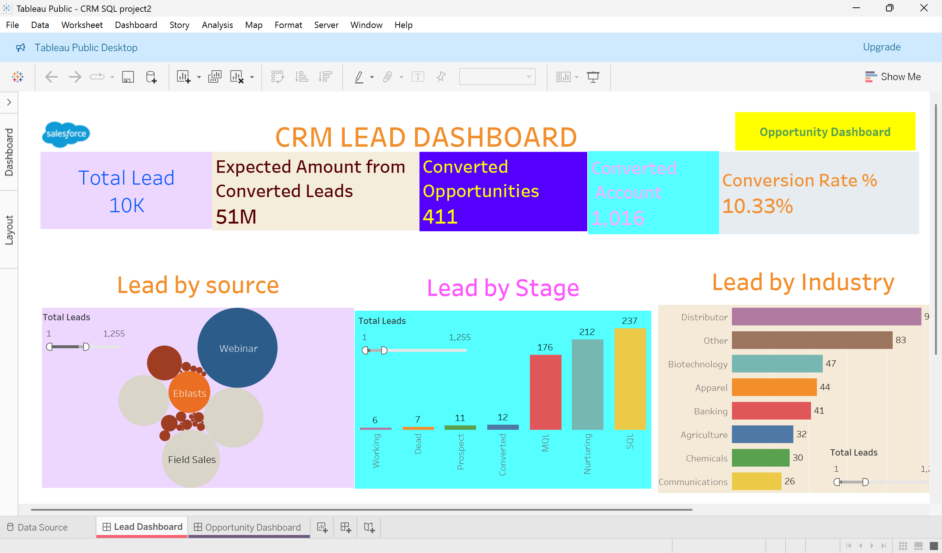
Lead Dashboard: Shows 10K Total Leads, $184M Expected Amount, 10.33% Conversion Rate, 699 Converted Accounts, 411 Converted Opportunities.
Tableau Dashboard
Opportunity Dashboard: Displays $1,023M Expected Amount, 1,272 Active Opportunities, 31% Conversion Rate, 31.06% Win Rate, 42% Loss Rate.

Slide 8
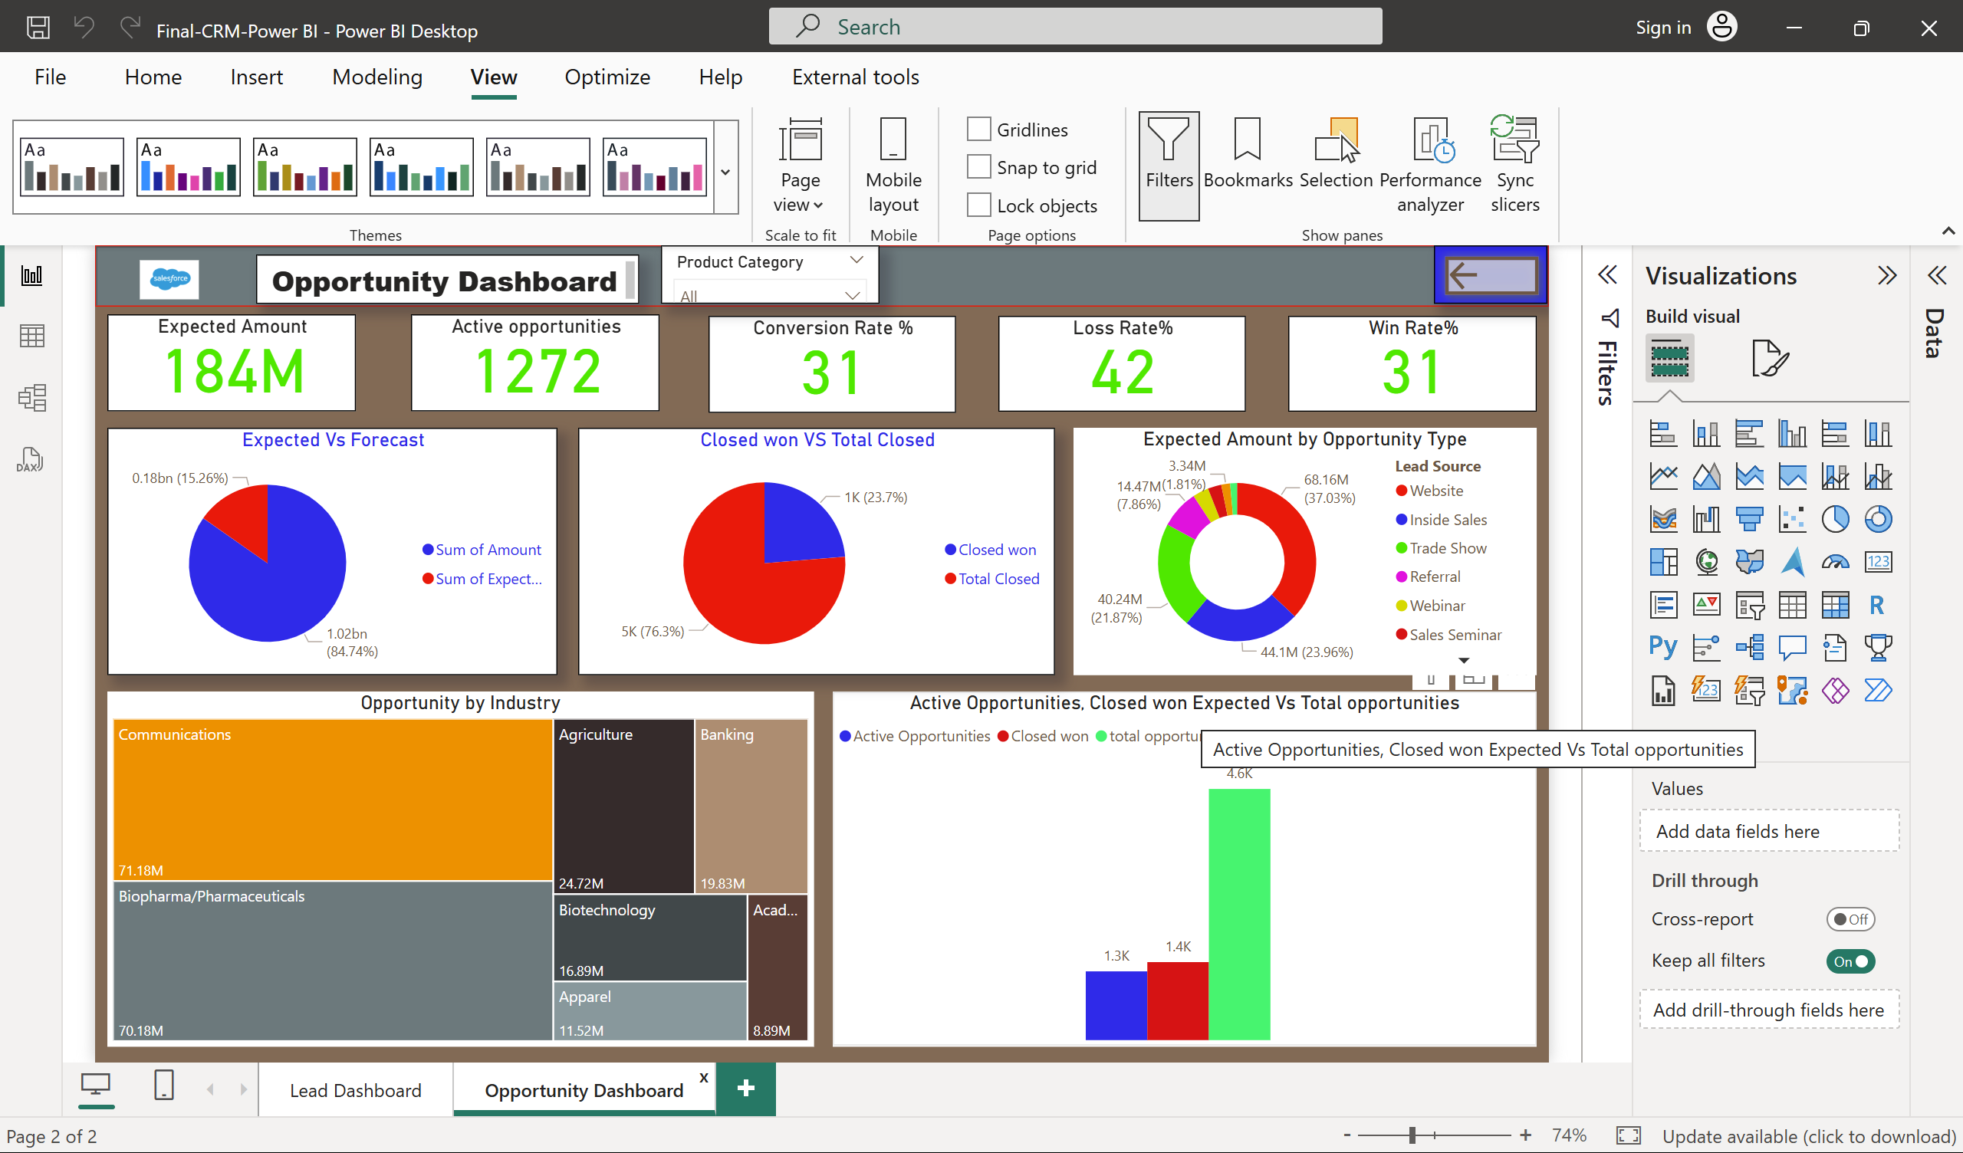
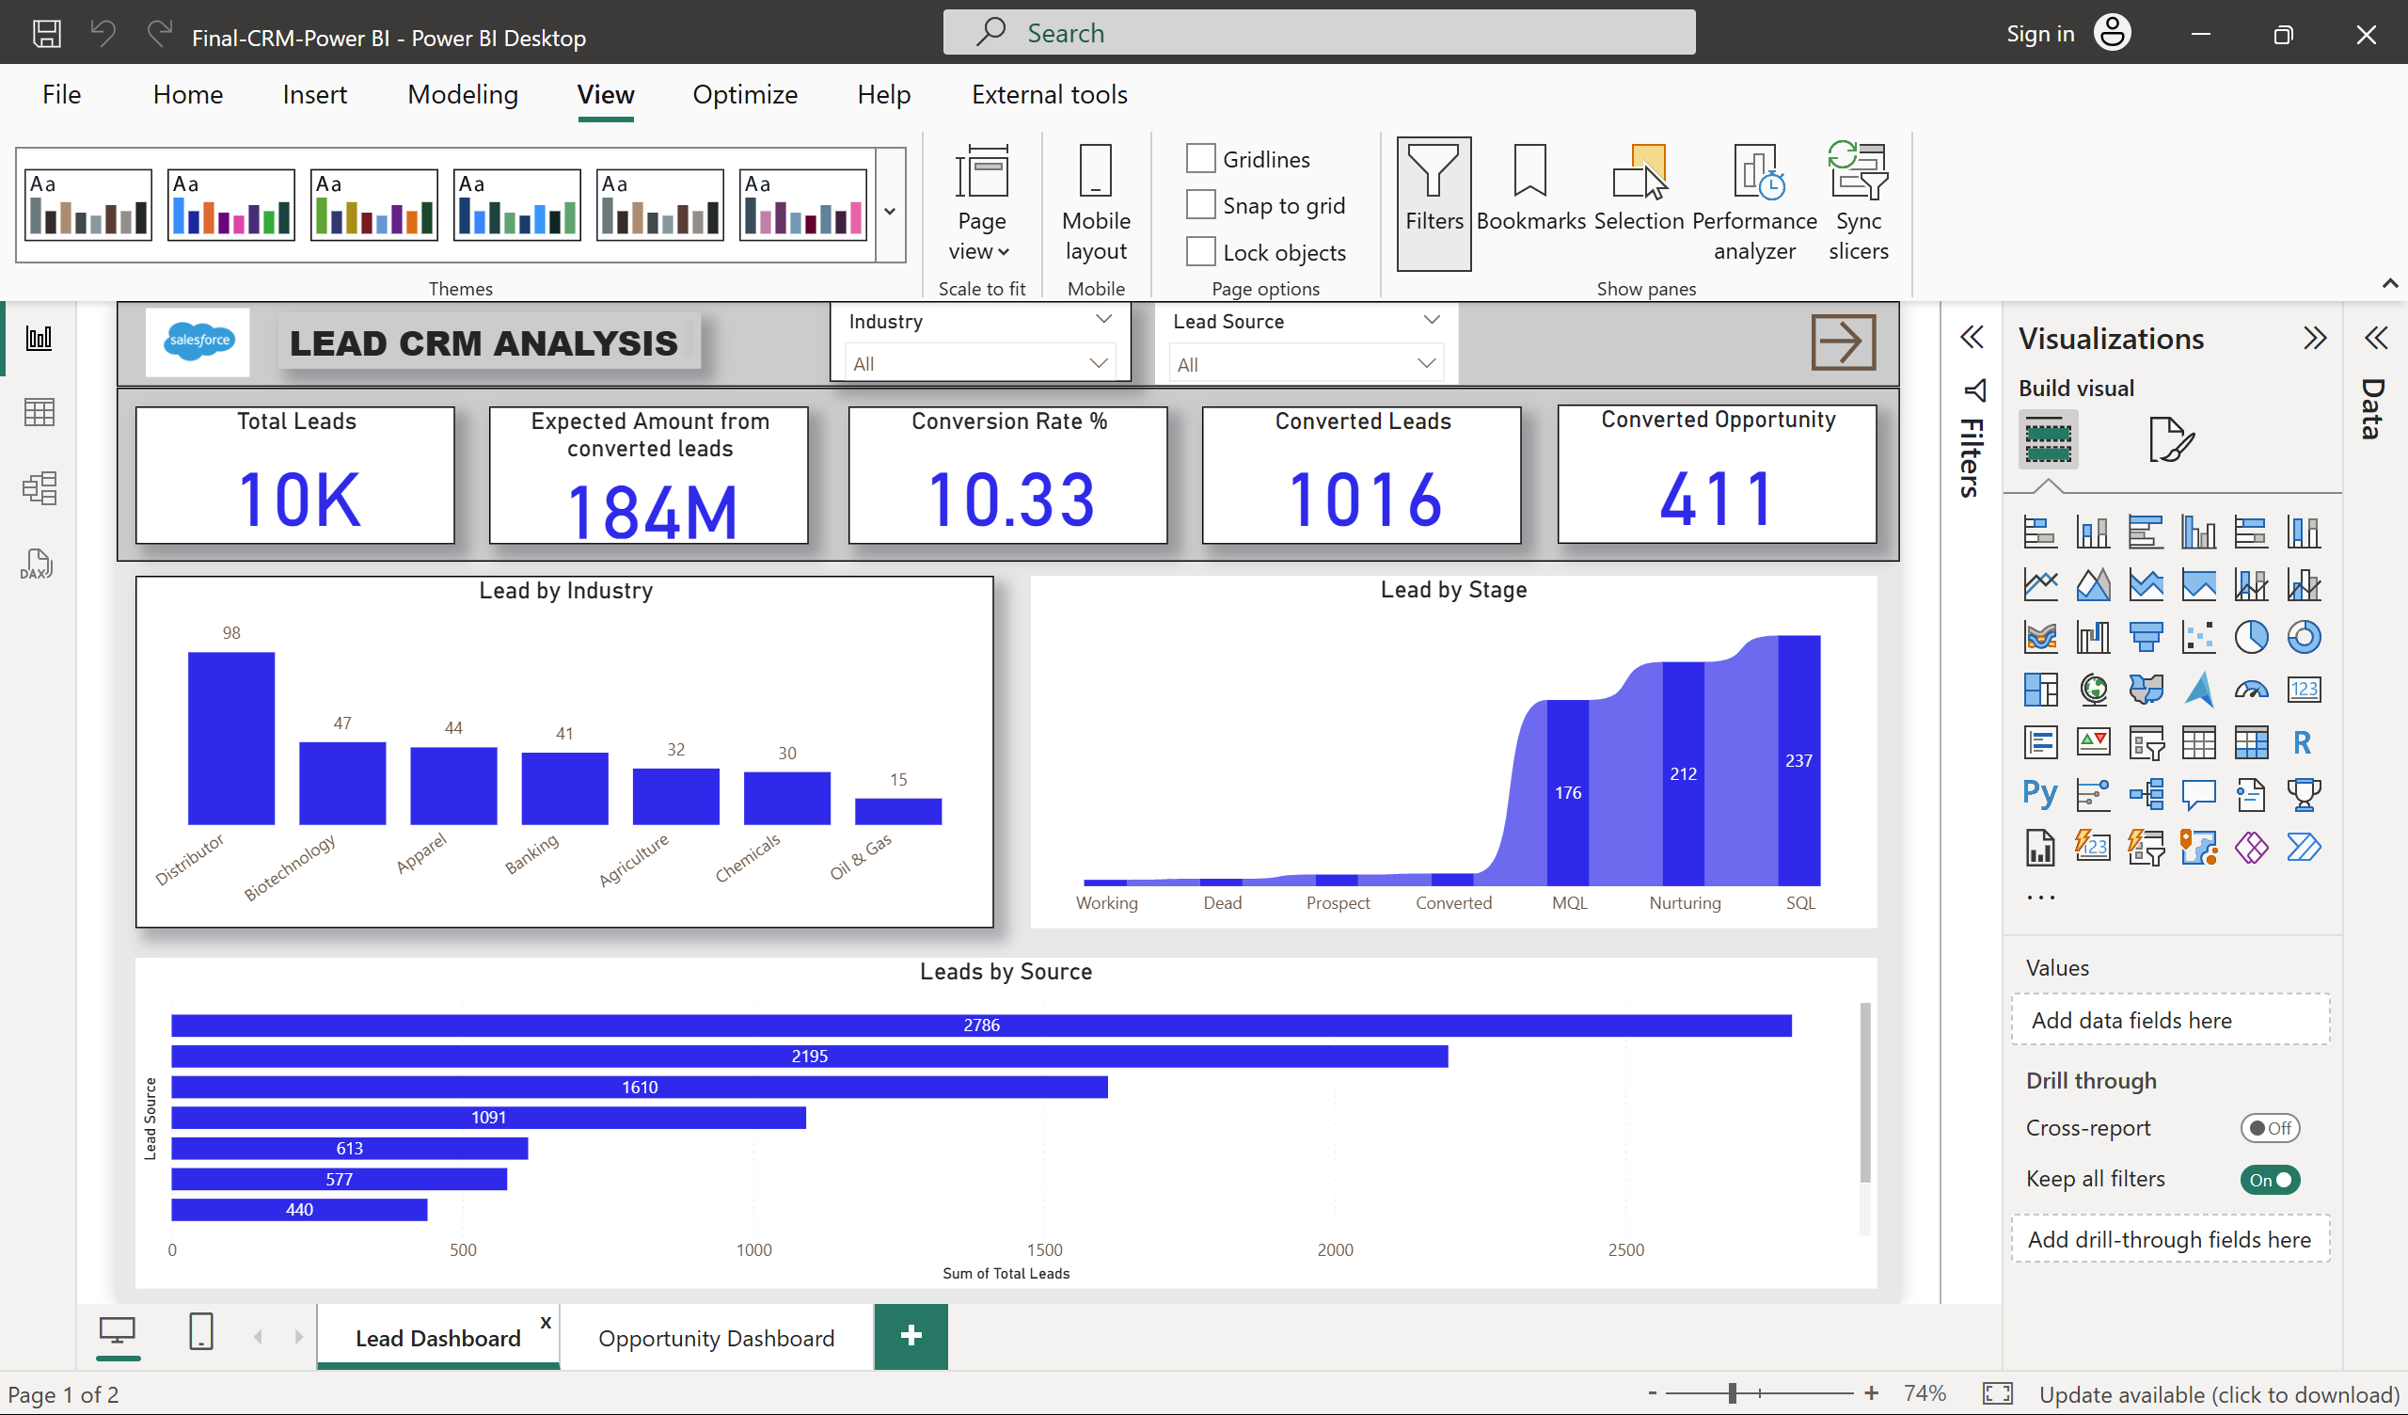
Lead Dashboard: Tracks 10K Total Leads, $184M Expected Amount, 10.33% Conversion Rate, 1,016 Converted Leads, 411 Converted Opportunities.
Power BI Dashboard
Opportunity Dashboard: Monitors $1,023M Expected Amount, 1,272 Active Opportunities, 31% Conversion Rate, 31.06% Win Rate, 42% Loss Rate.

Slide 9
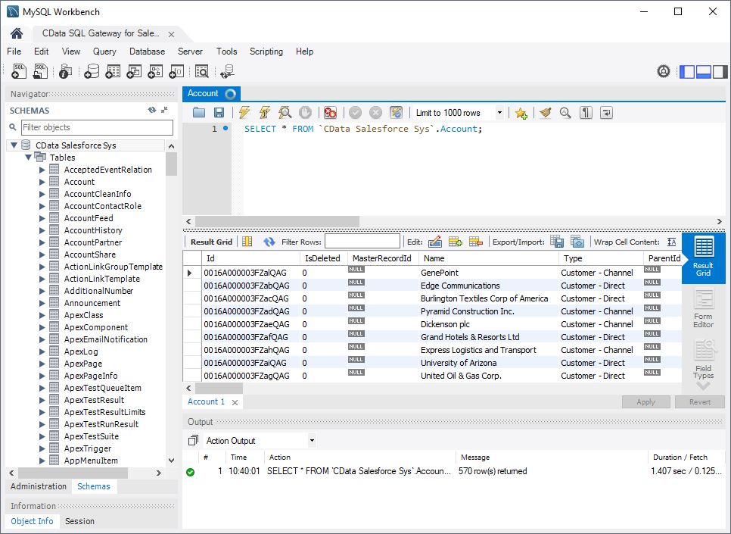
SQL Query Image

Slide 10
Key Takeaways
Key Takeaways
Business Insights: With 10K leads and $1,023M expected revenue, the sales pipeline is strong (as of 09:11 AM IST, July 05, 2025).
Challenges: Keeping data consistent and handling future dates is tricky.
Future Recommendations: Add churn analysis, customer segmentation, and real-time updates.

Slide 11


